Slide 1

Vel Tech Rangarajan Dr. Sagunthala R&D Institute of Science and Technology
School of Computing
Department of Computer Science and Engineering
10211CS224 / FULL STACK APPLICATION DEVELOPMENT (JAVA)
PROJECT REVIEW : MILESTONE PROJECT – 1
Date: 25-03-2026
SmartExam: Online Examination System
SDG: SDG 4 – Quality Education
Presented By:
STUDENT NAME – VTU26314 – 23UECS0986
Courses Handling Faculty:
Dr. Hemamalini - Designation

Slide 2
INTRODUCTION
This project is a comprehensive digital platform designed for modern online assessments.
The system provides a secure environment for students to access and complete exams.
It addresses the growing demand for remote, scalable, and efficient testing solutions.
- This full-stack application ensures a seamless transition between user login and testing.
The interface displays a dynamic list of available exams tailored to the user profile.
An integrated real-time countdown timer is used to maintain strict exam integrity.
Automated logic provides instant score calculation immediately upon exam submission.
The secure logout functionality ensures that user sessions and data remain protected.
1
2
3
4
5
6
7
8
9

Slide 3
PROBLEM STATEMENT
Manual examination processes are often inefficient and lead to significant administrative delays.
Coordinating multiple assessments across a large user base without a centralized platform is difficult.
Managing strict time constraints for individual candidates is challenging without automated controls.
The lack of robust authentication protocols poses a risk to the integrity of the examination process.
Processing and calculating scores manually is a slow task that is highly prone to human error.
Existing non-automated setups often fail to provide a real-time environment for remote test-takers.
There is a clear need for a reliable, fully digital system that manages both users and exams simultaneously.
This project addresses these gaps by providing an integrated full-stack solution for instant assessment.
1
2
3
4
5
6
7
8
9

Slide 4
OBJECTIVE(S)
To design and develop a centralized web-based assessment platform:
Develop a secure authentication system to manage user access and maintain data
privacy.
Build a dynamic user interface that allows candidates to browse and select available examinations easily.
Establish a seamless end-to-end workflow from secure login to a clean logout process.
- To implement automated examination controls and result management:
Integrate a real-time countdown timer to enforce strict time limits and ensure a fair testing
environment.
Develop a server-side scoring engine to calculate results instantly and accurately upon
submission.
Reduce administrative workload by automating the transition from test-taking to
performance evaluation.
1
2
3
4
5
6
7
8
9

Slide 5
PROPOSED SYSTEM
Centralized Web Platform: A full-stack solution to manage the entire examination lifecycle.
Secure Access: Authentication module ensuring only registered users can access exams.
Automated Dashboard: Replaces manual coordination by displaying all available tests dynamically.
Precision Timing: Integrated countdown timer to enforce strict and fair session limits.
Instant Evaluation: Automated logic for immediate score calculation upon test submission.
Responsive Interface: An intuitive design that works seamlessly across various user devices.
Reduced Overhead: Minimizes administrative tasks by automating the assessment workflow.
Secure Session End: A robust logout protocol to terminate sessions once results are displayed.
1
2
3
4
5
6
7
8
9

Slide 6
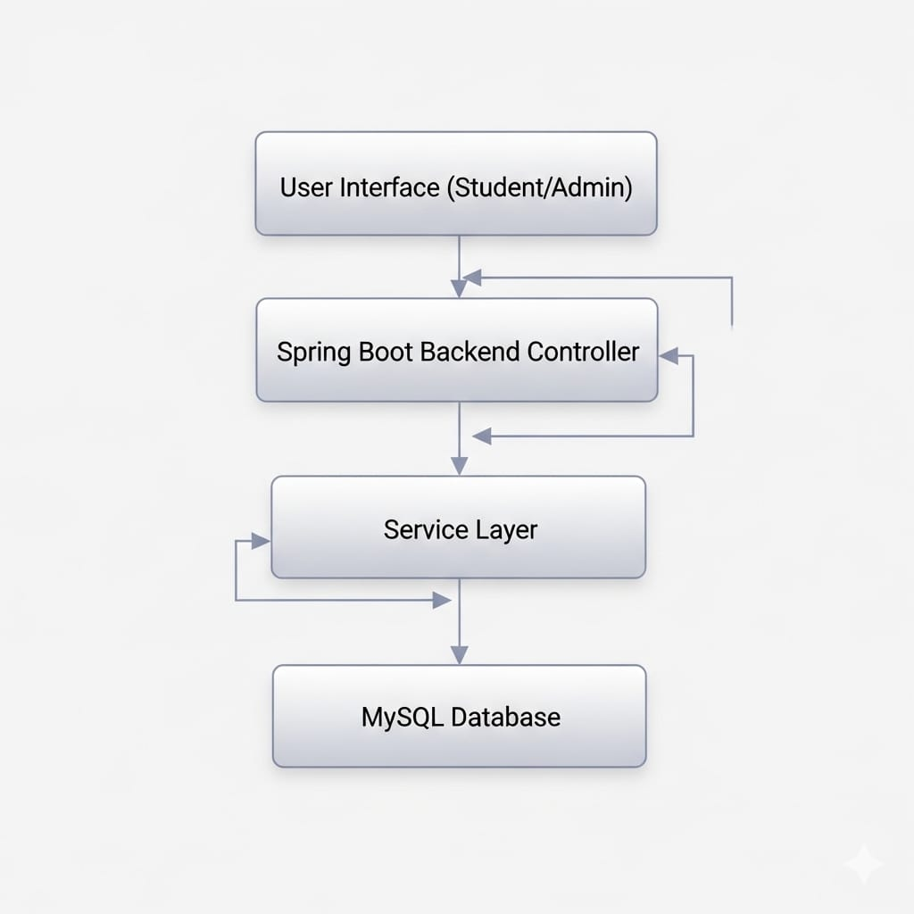
PROPOSED SYSTEM ARCHITECTURE
1
2
3
4
5
6
7
Input Layer:
Users securely authenticate and submit responses through Thymeleaf HTML templates (like login.html, exam.html).
The input data is then passed to the appropriate Java REST Controllers within the backend.
8
9

Slide 7
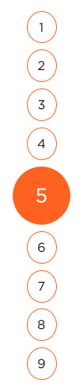
Processing Layer:
Controllers use core backend logic (such as in Auth/Exam Controllers) to validate users and handle real-time countdown timer operations.
Server-side evaluation logic calculates results immediately upon test submission.
Database Layer:
Spring Data JPA Repositories manage all database interactions, adhering to the standard layered architecture.
This layer handles the retrieval and secure storage of user profiles, exam questions, and student scores.
Output Layer:
A dynamic response is generated and rendered through the result.html template, providing immediate feedback to the student.
The system displays the final calculated total marks along with the user’s Pass/Fail status.

Slide 8
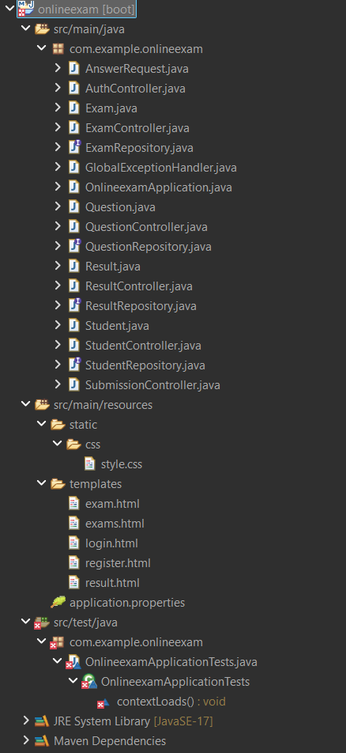
WORKFLOW
1
2
3
4
5
6
7
8
9

Slide 9
TECHNOLOGIES USED
Frontend: HTML5 & Thymeleaf (Template Engine)
CSS3 (Custom Styling)
JavaScript (Timer Logic & UI Interactivity)
Backend:
Java 17 (Core Language)
Spring Boot (Web Framework)
Spring Data JPA (ORM/Database Management)
Database:
MySQL / H2 Database
1
2
3
4
5
6
7
8
9

Slide 10
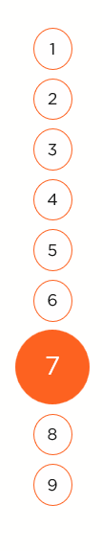
Tools:
Eclipse IDE (Development Environment)
Maven (Build Automation and Dependency Management)
Postman (API Testing)
Hardware/Software Requirements:
OS: Windows 10/11 or macOS
Processor: Intel i3 or higher
RAM: Minimum 8GB
Software: JDK 17+, Any Modern Web Browser (Chrome/Edge/Firefox)

Slide 11
MODULE DESCRIPTION
Module 1: User Management
Handles secure registration and login processes using AuthController.java.
Manages user data and session persistence through the Student entity and repository.
Module 2: Examination Dashboard
Dynamically retrieves and displays a list of available exams via ExamController.java.
Provides students with clear metadata including test titles, durations, and total marks.
1
2
3
4
5
6
7
8
9

Slide 12
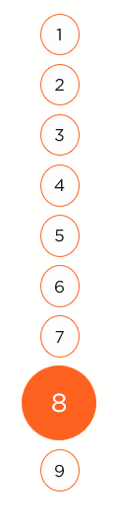
Module 3: Core Exam Engine
Manages the active testing environment using QuestionController.java and exam.html.
Integrates a synchronized countdown timer to enforce strict session limits.
Module 4: Automated Evaluation and Results
Processes AnswerRequest data through SubmissionController.java for real-time grading.
Generates instant performance feedback and displays the final score on the result.html template.

Slide 13
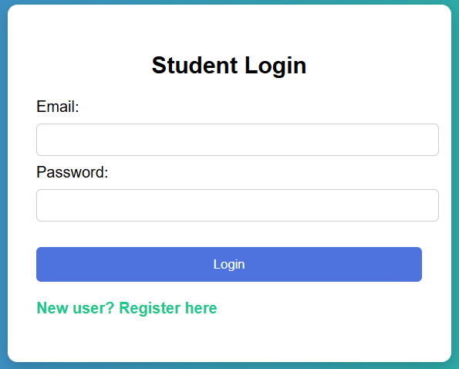
IMPLEMENTATION SCREENSHOTS
Registration & Login Page:
A secure gateway that validates user credentials and manages new student registrations using Spring Security principles.
1
2
3
4
5
6
7
8
9

Slide 14
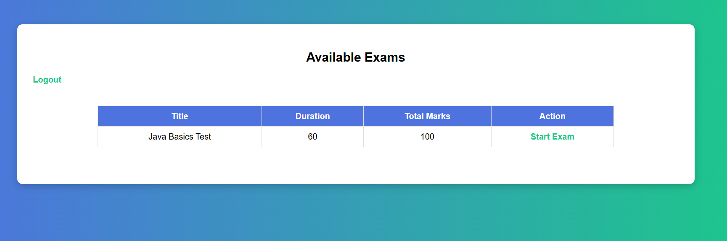
IMPLEMENTATION SCREENSHOTS
Student Dashboard (Home Page):
A dynamic landing page that retrieves and displays a live list of available exams, durations, and total marks from the database.
1
2
3
4
5
6
7
8(A)
9

Slide 15
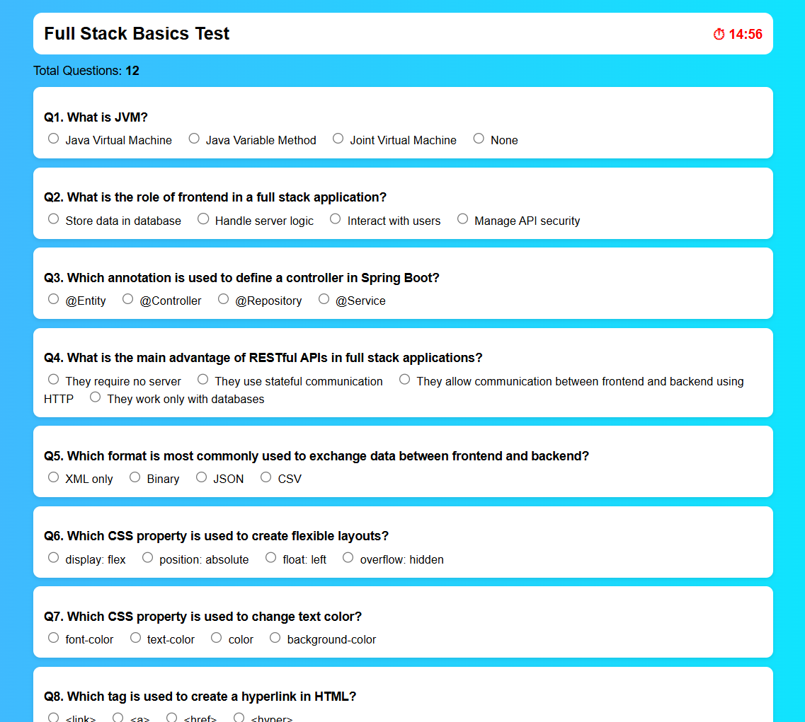
IMPLEMENTATION SCREENSHOTS
Examination Interface (Main Module):
A dynamic landing page that retrieves and displays a live list of available exams, durations, and total marks from the database.
1
2
3
4
5
6
7
8(B)
9

Slide 16
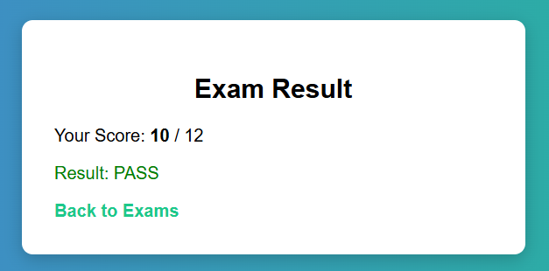
IMPLEMENTATION SCREENSHOTS
1
Result Generation (Output Page):
A controlled testing environment featuring a real-time countdown timer and an interactive layout for answering multiple-choice questions.
2
3
4
5
6
7
8(C)
9

Slide 17
ADVANTAGES & LIMITATIONS
- Advantages:
Instant Evaluation: Automates the grading process, providing students with immediate scores and Pass/Fail status upon submission.
Time Discipline: Enforces strict exam integrity using a real-time countdown timer that automatically closes the session when time expires.
- Limitations:
Connectivity Dependency: Requires a continuous and stable internet connection to ensure data sync between the frontend and the database.
Assessment Scope: Currently restricted to Multiple Choice Questions (MCQs), lacking support for descriptive answers or file uploads.
1
2
3
4
5
6
7
8
9

Slide 18
Thank you

